Slide 1
SUPERMARKET ANALYSIS
MICROSOFT POWER BI

Slide 2
Introduction
In this project, we will be using Power BI to analyze the supermarket sales dataset. We will perform data cleaning, preprocessing, and exploratory data analysis to understand
the patterns and trends in the data. We will also create visualizations and reports to
present the data and gain insights

Slide 3


Project Goals
A
Analyzing the trend
Determining popular products
Understanding Impact of Sales
Identifying Valuable Customers
Analyzing Customer Ratings

Slide 4
Primary goals
Gaining Insights from the Data Retrieved

Slide 5
Project Plans
Create Imagery & Animations
Connect
Connect the database to retrieve the data
Clean
Remove nulls and Nans
Pre-Process
Handle Missing Values
Gain Insights on the data
Visualize
Analyze

Slide 6
Slicers Used on
Slicer to select between different products
Cities
Slicer to make a selection between all the three cities
Gender
Select an alternative between Male/Female
Customer Type
This Slicer is to filter between Member or Normal customer
Payment Mode
Choice between the payment type between the 3
Product Line

Slide 7
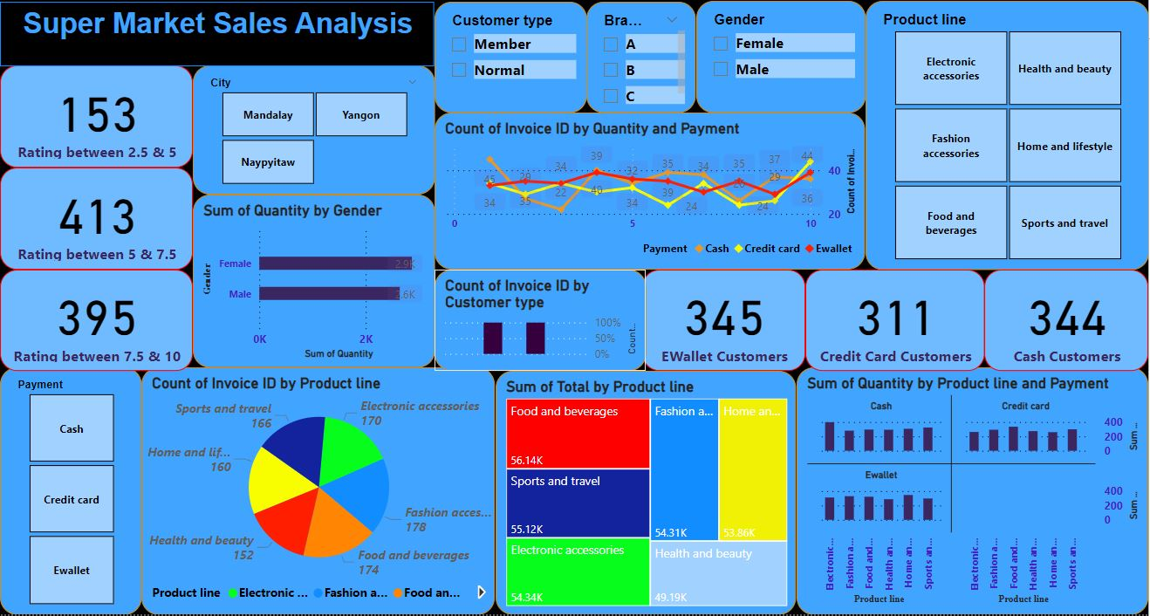
Dashboard
Dashboard consisting of all the Charts and visualizations and slicers to filter the data by

Slide 8
Charts used for representation of the data
1.Pie Chart
Stacked Column Chart
Line Chart
TreeMap
Stacked Bar Chart
100% Column Chart

Slide 9
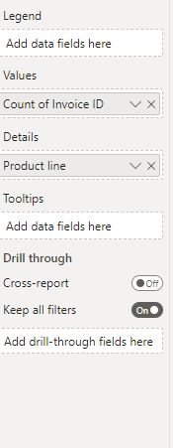
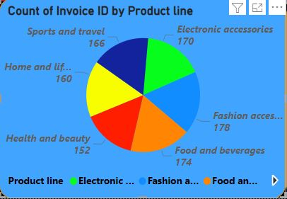
PIE CHART
This pie chart is used to filter data between all the product lines and how many people bought which product out of all the 6 product line present and their exact count filtered and differently color presented using highlighted colors.

Slide 10
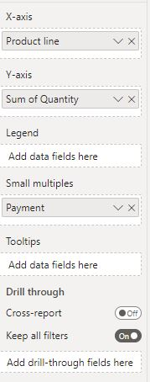
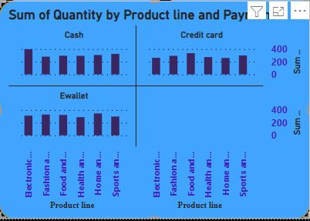
Stacked Column Chart
This Stacked Column Chart is used to filter data out in multiple layers which is firstly there is a sub division between Payment Method using small multiples to show how many customers used which payment method and then internal column charts represent the division between Product line bought by customers.

Slide 11
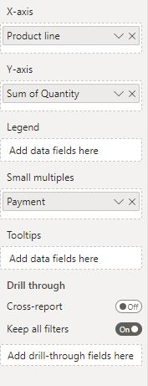
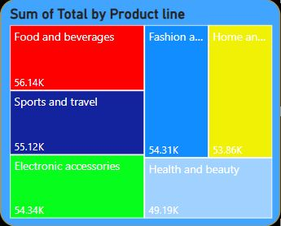
TREE MAP
This tree map is used to filter out between the expenditure between all the products and how much is spent by all the customers on various products

Slide 12
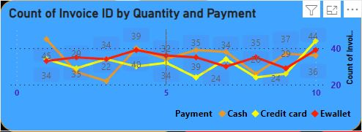
TREE MAP
Line chart shows the division between quantity bought by each customer using their own preferred mode of payment

Slide 13
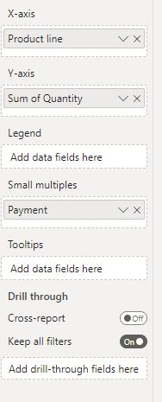
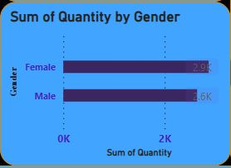
Bar Chart
This bar chart in this Dashboard represents the quantity of products that are bought by each gender

Slide 14
Summary
This analysis on the supermarket sales data gives us the insight about all the customers belonging from different cities like the product lines ,quantity of product they are interested in buying . This in-depth analysis help us understand the sales trend & customer behavior. we can gain insights into which products are selling the most, what factors influence sales, and which customers are the most valuable

Slide 15
Thank you

